Slide 1
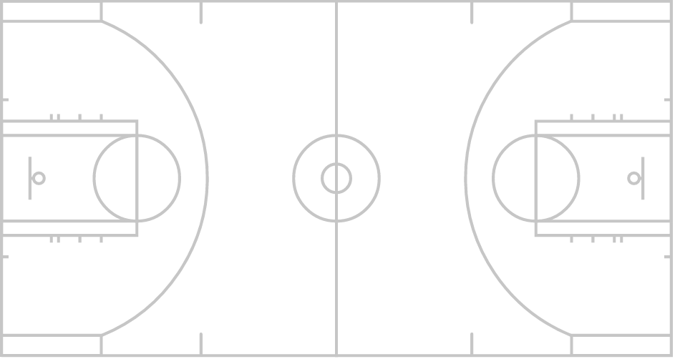
RFM Beacon
Goal RFM Beacon
User
Central processing node

